Slide 1

Crop Yield Analysis
Jaimin Vyas

Slide 2
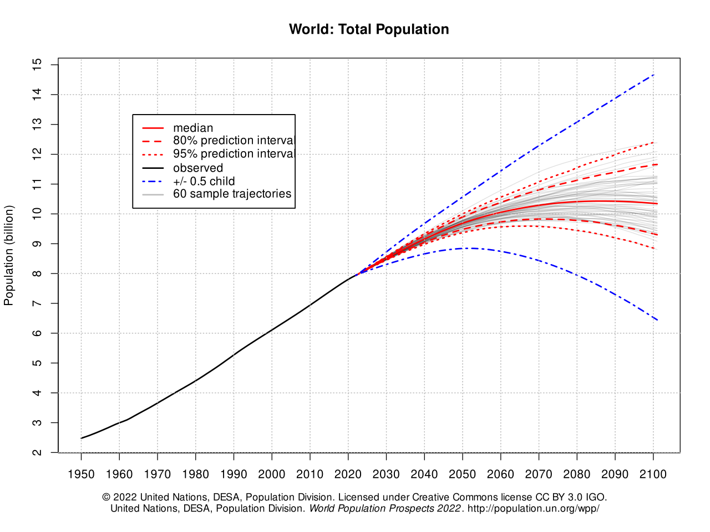
Why This Topic?
World population increasing, food shortage becoming a very real concern.
Potential hypothesis:
What kinds of climate variables impact crop yields?
How does climate variability impact crop yield across countries?

Slide 3
The Data
United States Department of Agriculture – Production, Supply and Distribution data portal for crop yield data: https://apps.fas.usda.gov/psdonline/app/index.html#/app/home
NASA – Land Surface Temperature, Precipitation, Vegetation (NDVI) on Google Earth Engine for climate data: https://developers.google.com/earth-engine/datasets/catalog
NASA – Global Agricultural Monitoring System for time series of NDVI: https://glam1.gsfc.nasa.gov/

Slide 4
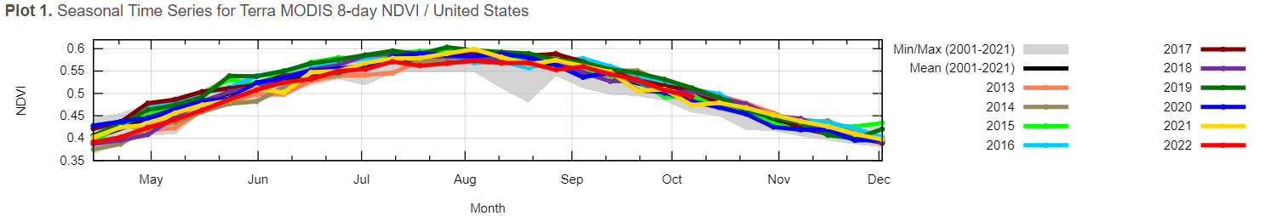
Analysis
Time series data
Regression/Autoregressive models, Recurrent Neural Networks
Analyze climate variables as predictors for crop yield
EDA to determine which climate variables impact crop yield the most, in what way
Sensitivity analysis (feature importance)

Slide 5
Application
R/AR or RNN to forecast future crop yield trends
Plenty of data to backtest on
Uncertainty can come from
External variables impacting crop yield that are not included in the data
Computer error when collecting data
Ideally would like to have an accurate crop yield prediction
Could be short-term, predicting next season’s crop yield

Slide 6
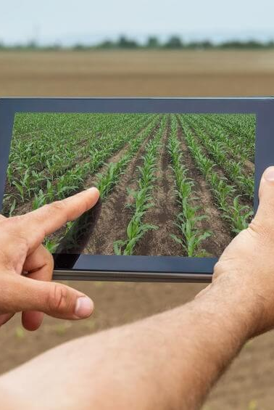
Prediction
Using future climate projections, predict crop yield by country
Can use this to find optimized locations to grow certain crops
Can use this to determine if growing more of another crop has higher value
Can maybe start growing different kinds of crops

